Slide 1
IT628: Systems Programming
IPC - pipes

Slide 2
Parent child communication
After fork() is called we end up with two independent processes
We cannot use variables to communicate between processes as they each have separate address spaces, and separate memory
One way to communicate is to use pipes

Slide 3
Pipes
Pipes are a mechanism for communication between related processes
A pipe is implemented as an internal OS buffer
One process write to the pipe, the other reads from the pipe
Can read from or write to the pipe like a real file

Slide 4
Opening a pipe
int pipe(int fds[2]);
fd needs to be an array of 2 ints
return value is 0 on success, -1 on error
on success, a new pipe is created
fds[0] will be the fd for the read end of pipe
fds[1] will be the fd for the write end of pipe

Slide 5
First pipe example
#define MSGSIZE 16
char *msg1=“hello, world #1”;
char *msg2=“hello, world #2”;
char *msg3=“hello, world #3”;
int main()
{
char inbuf[MSGSIZE];
int p[2], i;
if (pipe(p) < 0)
exit( 1 );
/* continued */
/* write pipe */
write( p[1], msg1, MSGSIZE );
write( p[1], msg2, MSGSIZE );
write( p[1], msg3, MSGSIZE );
for ( i=0; i < 3; i++ )
{
/* read pipe */
read( p[0], inbuf, MSGSIZE );
printf( “%s\n”, inbuf );
}
return 0;
}
pipedemo1.c

Slide 6
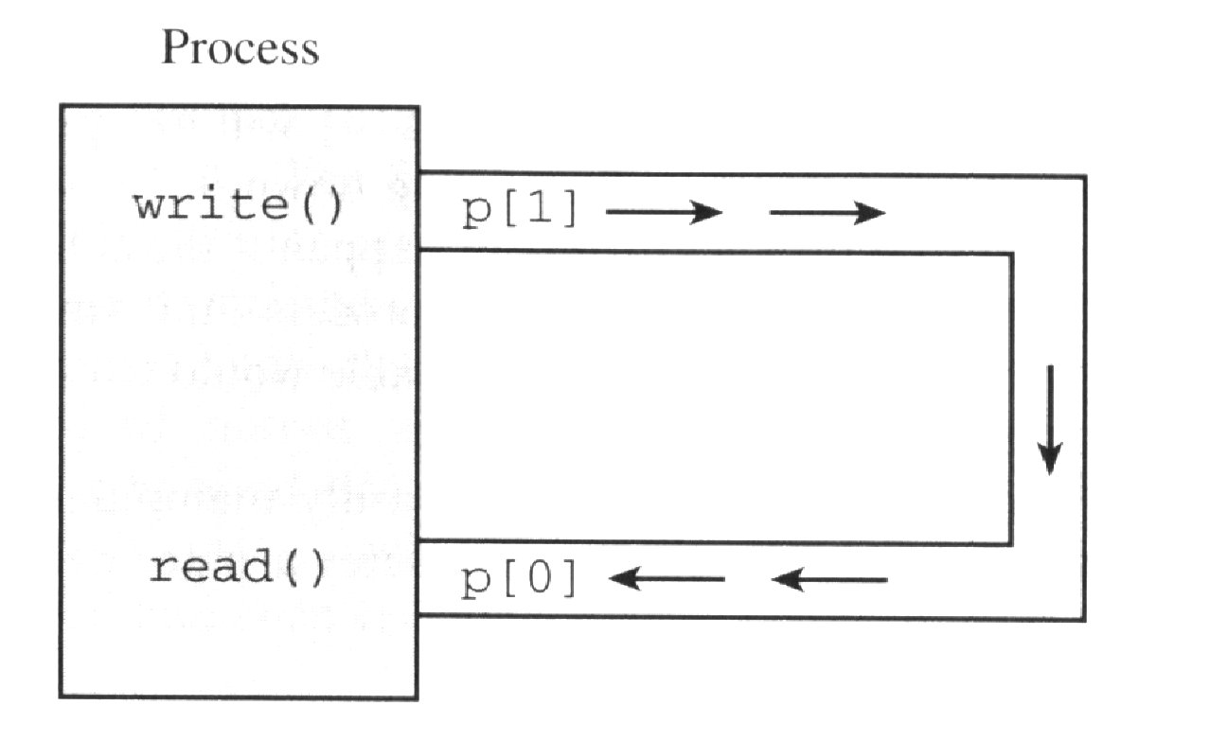
Program execution
Output:
hello, world #1
hello, world #2
hello, world #3

Slide 7
More on pipes
Pipes behave first-in-first-out (FIFO)
bytes placed in the pipe with write are returned by read in order
What kind of data structure you might use to implement a pipe?
The size of read and write don’t have to match
e.g. you can write 512 bytes at a time while reading 1 byte at a time
Pipes are of little use within a single process!

Slide 8
Parent and child sharing a pipe
Recall that file descriptors remain open across a call to fork
If we call fork after creating a pipe, then the parent and child can communicate via the pipe!
parent process
child process
fd[0]
fd[1]
fd[0]
fd[1]
pipe
kernel

Slide 9
Second pipe example
#define MSGSIZE 16
char *msg1=“hello, world #1”;
char *msg2=“hello, world #2”;
char *msg3=“hello, world #3”;
int main()
{
char inbuf[MSGSIZE];
int p[2], pid, nbytes;
if (pipe(p) < 0)
exit( 1 );
/* continued */
if ((pid = fork()) > 0) {
write(p[1], msg1, MSGSIZE);
write(p[1], msg2, MSGSIZE);
write(p[1], msg3, MSGSIZE);
wait(NULL);
}
else {
while ((nbytes =
read(p[0], inbuf, MSGSIZE)) > 0)
printf(“%s\n”, inbuf);
if (nbytes != 0)
exit(2);
printf(“Finished reading\n”);
}
return 0;
}
pipedemo2.c

Slide 10
Program execution
$ a.out
hello world, #1
hello world, #2
hello world, #3
(hangs)
Outcome
After finishing reading/writing, both parent and child block (instead of terminating)

Slide 11
Rules for reading a pipe
A read call gets as much data as it requests or as much data as the pipe has, whichever is less
If the pipe is empty
Reads on the pipe will return EOF (return value 0) if no process has the write end open
If some process has the pipe open for writing, read will block in anticipation of new data

Slide 12
Can you find the bug?
pipedemo2.c illustrates a common programming error
Neither the parent nor the child closes its write end
So child never sees EOF!
/* continued */
if ((pid = fork()) > 0) {
write(p[1], msg1, MSGSIZE);
write(p[1], msg2, MSGSIZE);
write(p[1], msg3, MSGSIZE);
wait(NULL);
}
else {
while ((nbytes =
read(p[0], inbuf, MSGSIZE)) > 0)
printf(“%s\n”, inbuf);
if (nbytes != 0)
exit(2);
printf(“Finished reading\n”);
}
return 0;
}

Slide 13
Modified second pipe example
#define MSGSIZE 16
char *msg1=“hello, world #1”;
char *msg2=“hello, world #2”;
char *msg3=“hello, world #3”;
int main()
{
char inbuf[MSGSIZE];
int p[2], pid, nbytes;
if (pipe(p) < 0)
exit( 1 );
/* continued */
if ((pid = fork()) > 0) {
write(p[1], msg1, MSGSIZE);
write(p[1], msg2, MSGSIZE);
write(p[1], msg3, MSGSIZE);
close(p[1]);
wait(NULL);
}
else {
close(p[1]);
while ((nbytes =
read(p[0], inbuf, MSGSIZE)) > 0)
printf(“%s\n”, inbuf);
if (nbytes != 0)
exit(2);
printf(“Finished reading\n”);
}
return 0;
}

Slide 14
Atomic writes
Atomic means no other process ever observes it partially done
Consequence: When multiple processes are writing to a pipe, the messages won't get mixed up
Process 1 sends a 100-byte message
At the same time, process 2 sends a 100-byte message
No guarantee about the order, but pipe will receive all of one message followed by all of the other

Slide 15
Non-atomic writes
Writes of up to PIPE_BUF (4096) bytes are atomic
For larger writes there is no such guarantee, data could get confusingly intermingled
writer
hello…
writer
bye…
hebypiz…
reader
writer
pizza…

Slide 16
Non-atomic writes
Demo: pipedemo3.c

Slide 17
Pipe capacity
There is a limit to the number of bytes a pipe can hold
Writes fill the pipe and block when the pipe is full
They block until another process reads enough data at the other end of the pipe and return when all the data given to write have been transmitted
Capacity of a pipe is at least 512 bytes, usually more (system dependent)

Slide 18
Program to find pipe capacity
int count;
void alrm_action(int signo)
{
printf("Write blocked
after %d characters\n", count);
exit(0);
}
int main() {
int p[2];
char c = 'x';
signal(SIGALRM, alrm_action);
if (pipe(p) == -1)
exit(1);
while (1) {
alarm(5);
write(p[1], &c, 1);
++count;
alarm(0);
}
}
pipedemo4.c

Slide 19
Non-blocking I/O with pipes
Sometimes it's convenient to have I/O that doesn't block
Example: Process checking two different pipes
Don't want a read call to block on one in case of input from the other

Slide 20
Non-blocking I/O with pipes
To specify non-blocking option:
int fd;
…
fcntl(fd, F_SETFL,O_NONBLOCK);
A call to read/write returns -1 if pipe empty/full and sets errno to EAGAIN

Slide 21
Non-blocking read example
Child writes “hello” to parent every 3 seconds
Parent does a non-blocking read each second
pipe p
p[0]
child
hello
parent
p[1]

Slide 22
Non blocking read example
#define MSGSIZE 6
char *msg1=“hello”;
char *msg2=“bye!!”;
int main()
{
int p[2], i;
if (pipe(p) < 0)
exit( 1 );
if (fcntl(p[0], F_SETFL,
O_NONBLOCK) < 0)
exit(2);
/* continued */
switch(fork())
{
case -1: /* error */
exit(3);
case 0:
child_write(p);
break;
default:
parent_read(p);
break;
}
return 0;
}
pipedemo5.c

Slide 23
parent_read
void parent_read(int p[])
{
int nread;
char buf[MSGSIZE];
close(p[1]); /* write link */
while(1)
{
nread = read(p[0], buf, MSGSIZE);
switch(nread)
{
case -1:
if (errno == EAGAIN) {
printf(“(pipe empty)\n”);
sleep(1);
break;
}
else {
perror(“read”);
exit(4);
}
case 0:
printf(“End of conversation\n”);
close(p[0]); /* read link */
exit(0);
default: /* text read */
printf(“MSG=%s\n”, buf);
}
}
}

Slide 24
child_write
void child_write(int p[])
{
int i;
close(p[0]); /* read link */
for (i=0; i<3; i++)
{
write(p[1], msg1, MSGSIZE);
sleep(3);
}
write(p[1], msg2, MSGSIZE);
exit(0);
}

Slide 25
Output
(pipe empty)
MSG=hello
(pipe empty)
(pipe empty)
(pipe empty)
MSG=hello
(pipe empty)
(pipe empty)
(pipe empty)
MSG=hello
(pipe empty)
(pipe empty)
(pipe empty)
MSG=bye!!
End of conversation

